Slide 1
Language and thought
How to express and understand thoughts.

Slide 2
"...the tools we are trying to use and the language we are using to express or record our thoughts are the major determining factors determining what we can think or express at all"
Edsger W. Dijkstra [1972]

Slide 3
Brain Games
Language Influences Thought/Memory

Slide 4
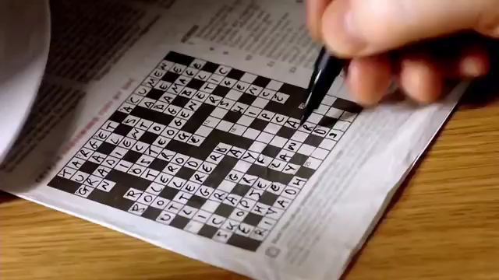

Slide 5
Thoughts and notations
Expressing thoughts

Slide 6
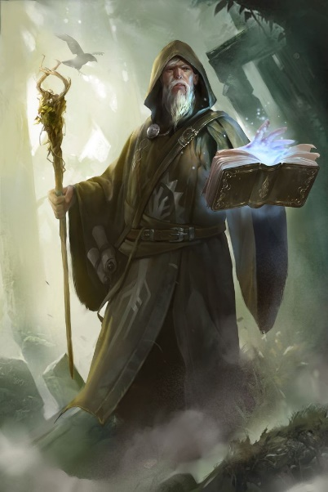
Socrates in Cratylus considers, without taking a position, the possibility whether names are "conventional" or "natural", that is, whether language is a system of arbitrary signs or whether words have an intrinsic relation to the things they signify
The ancient Jews considered God's true name so potent that its invocation conferred upon the speaker tremendous power over His creations. To prevent abuse of this power, as well as to avoid blasphemy, the name of God was always taboo, and increasingly disused so that by the time of Jesus their High Priest was supposedly the only individual who spoke it aloud — and then only in the Holy of Holies upon the Day of Atonement.
According to practices in folklore, knowledge of a true name allows one to affect another person or being magically. It is stated that knowing someone's, or something's, true name therefore gives the person (who knows the true name) power over them. This effect is used in many tales, such as in the German fairytale of Rumpelstiltskin: within Rumpelstiltskin and all its variants, the girl can free herself from the power of a supernatural helper who demands her child by learning its name.
In Scandinavian beliefs, more magical beasts, such as the Nix, could be defeated by calling their name. For the same reason significant objects in Germanic mythology, which were considered to have some kind of intrinsic personality, had their own names too, for example the legendary Sword Balmung.
https://en.wikipedia.org/wiki/True_name

Slide 7
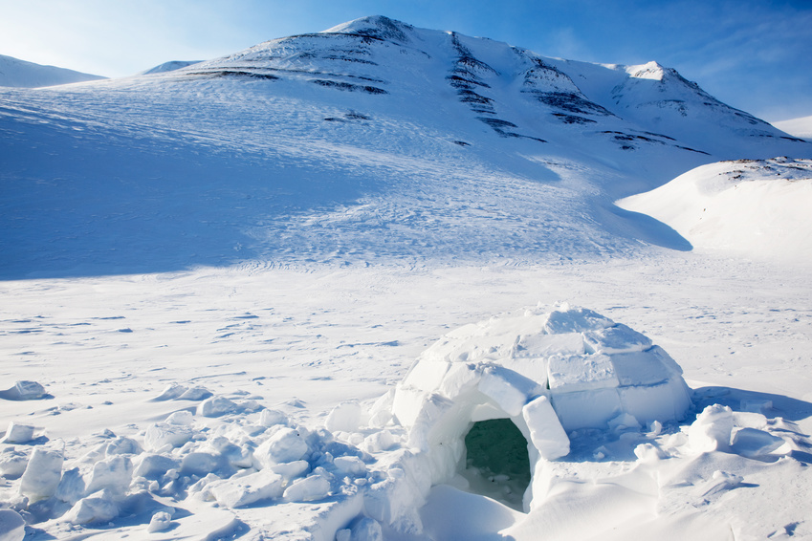
Capturing thoughts through abstractions (aka names)
Eskimos have 50 names for snow

Slide 8
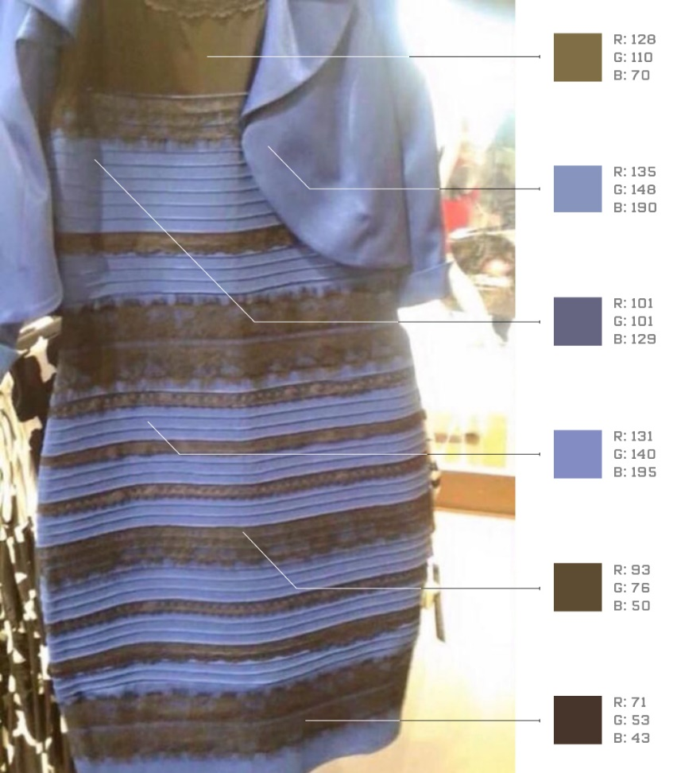
What color is this dress

Slide 9
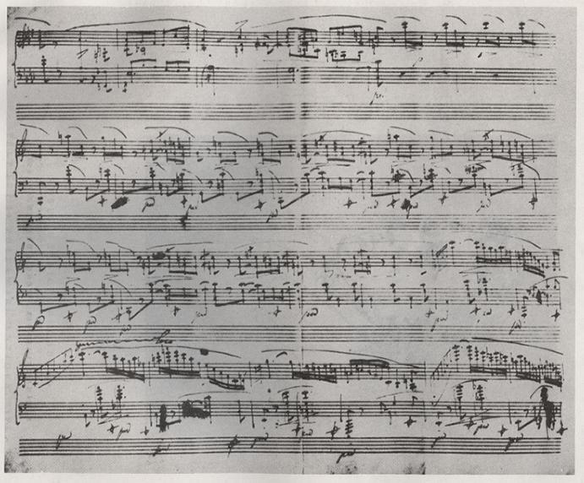
Sequences of States
Chopin Ballade in A Flat Major (Bars 99 - 123)

Slide 10
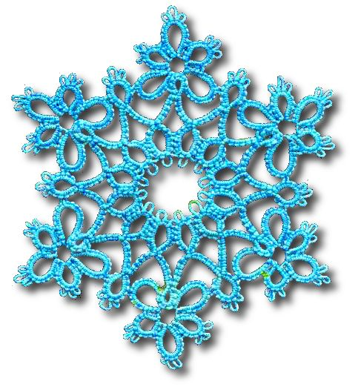
Sequences Creating a single state

Slide 11
Rnd 1: Start a chain, leaving a loop large enough to bring the shuttle through later - ch 3, vsp, ch 3, bring the shuttle through the loop and draw tight - Mock Ring made.
Rnd 2: *Vsp, (ch 2 ds, vsp) twice, ch 2 ds, j to next vsp, repeat from * once more.
Rnd 3: (Vsp, ch 3 ds, j to next vsp) 6 times.
Rnd 4: (Vsp, ch 4 ds, j to next vsp) 6 times.
Rnd 5: (Vsp, ch 2 ds, lp, ch 3, lp ch 2, j to next vsp) 6 times.
Rnd 6: *Ch 6, j to next 2p tog, r of (3 ds, p) 3 times, 3 ds, cl. R of 3 ds, j to last p of previous r, (5 ds, p) twice, 3 ds, cl. R of 3 ds, j to last p of previous r, (3 ds, p) twice, 3 ds, cl. Ch 6, j to next vsp, Repeat from *5 times more.

Slide 12
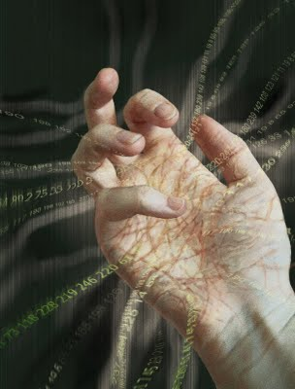
Precision
The importance of numbers

Slide 13
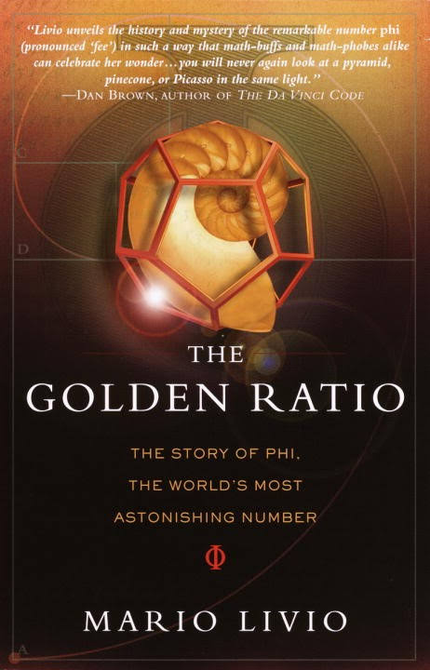

Slide 14
Numbers
Cardinal numbers (size) – one, two, three, …
Ordinal numbers (sequence) – first, second, third, …
What kinds of numbers were used to describe rituals?
What kinds of numbers were used to describe armies or herds of animals?

Slide 15
Abstraction
Numbers as contrasts
One wolf versus a pack of wolves
Numbers as abstract quantities and manifestations
Two hands
Two eyes
Two major lights in the heavens – the sun and the moon
Two nights
The first distinctions were made between 1 and 2, and 2 and many.

Slide 16
Primitive counting
Natives of the islands in the Torres Strait
Urapun = one
Okosa = two
Okosa-urapun = three
Okosa-okosa = four
Ras = many

Slide 17
A squire was determined to shoot a crow which made its nest in the watch-tower of his estate. Repeatedly he had tried to surprise the bird, but in vain: at the approach of man the crow would leave its nest. From a distant tree it would watchfully wait until the man had left the tower and then return to its nest. One day the squire hit upon a ruse: two men entered the tower, one remained within, the other came out and went on. But the bird was not deceived: it kept away until the man within came out. The experiment was repeated on the succeeding days with two, three, then four men, yet without success. Finally, five men were sent: as before, all entered the tower, and one remained while the other four came out and went away. Here the crow lost count. Unable to distinguish between four and five it promptly returned to its nest.
Tobias Dantzig, "Number, the Language of Science": 1930

Slide 18
Roman numbers
I
II
III
IV
V
VI
… ? What is the syntax for the number 967?

Slide 19
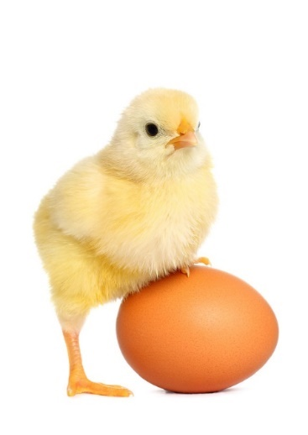
Syntax versus semantics
The chicken and the egg

Slide 20
Mapping Syntax to Semantics via a meaning function
m [ symbol ] = meaning of symbol

Slide 21
Roman Numeral | Meaning
I | m [ I ] = 1
V | m [ V ] = 5
X | m [ X ] = 10
L | m [ L ] = 50
C | m [ C ] = 100
D | m [ D ] = 500
M | m [ M ] = 1000
V | m [ V ] = m [ V ] * 1000

Slide 22
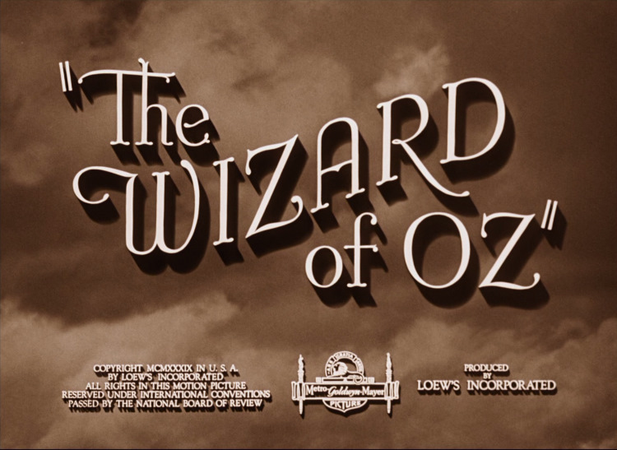
M [ MCMXXXIX ] = 1939

Slide 23
In Summary…
It was argued that (1) language influences how we think, (2)
notational issues are non-trivial and oftentimes not obvious, and
(3) there exists a theoretical gap between the symbols used to
denote a thing - its syntax, and the meaning of that thing - its
semantics.
Why are these issues important in the context of programming languages?

Slide 24
The End

